Slide 3
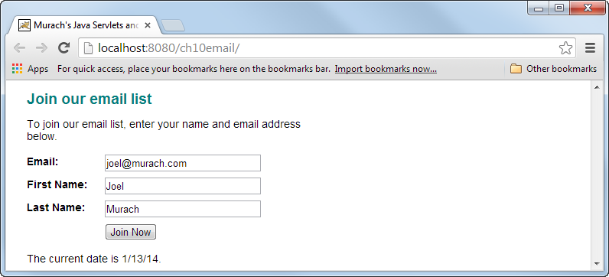
AJK reminder: the “stuff” between an XML start tag and its end tag is the body, e.g. <tag>body</tag>. If there is no body the tag must close itself, e.g.. <tag />

Slide 8
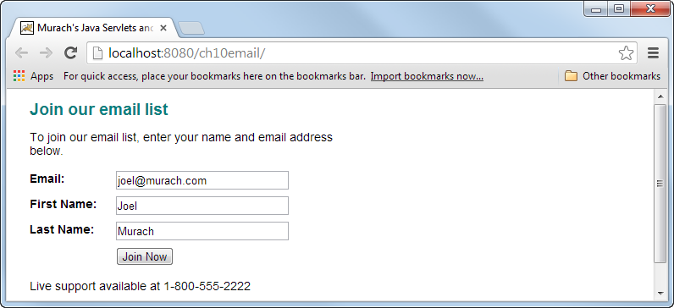

Slide 11
AJK note: there are other options, e.g. EVAL_BODY_BUFFER that allows the buffering and potential modifying of the content

Slide 13
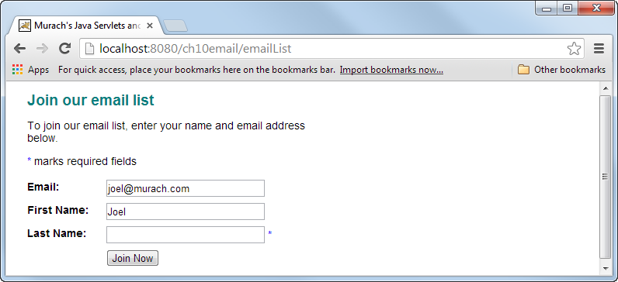

Slide 20
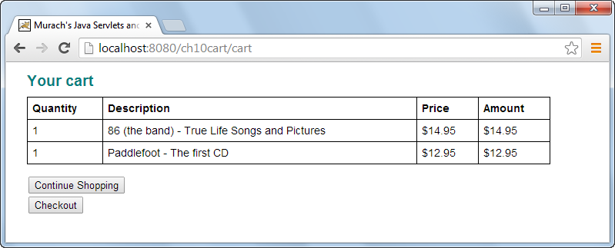

Slide 33
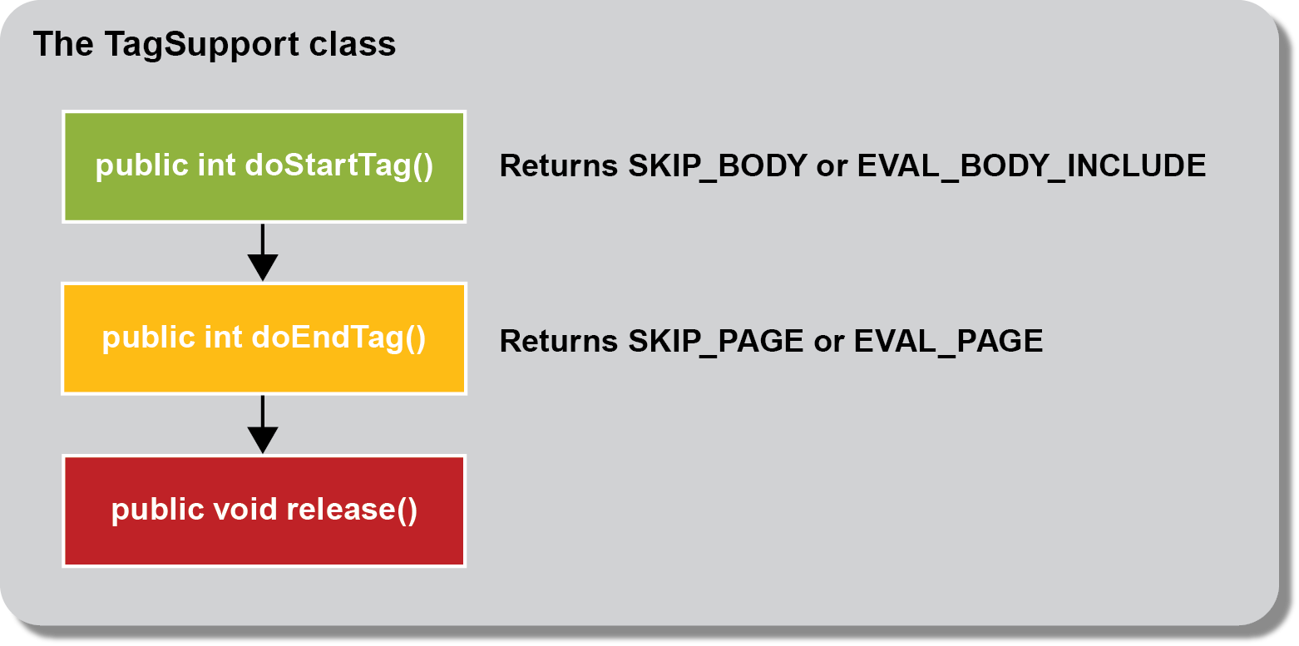

Slide 38
